Slide 1
Technical writing and presentation skills
Interview

Slide 2
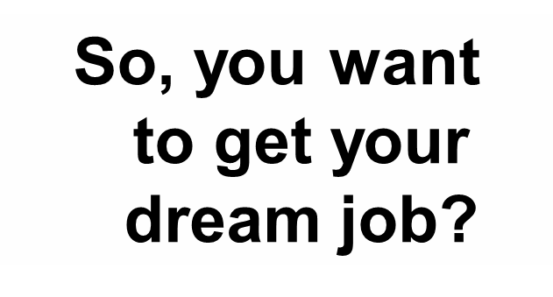



Slide 3
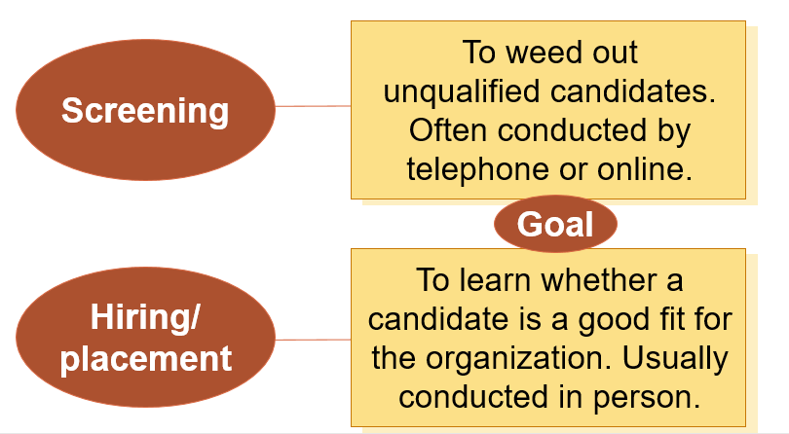
Types of Employment Interviews

Slide 4
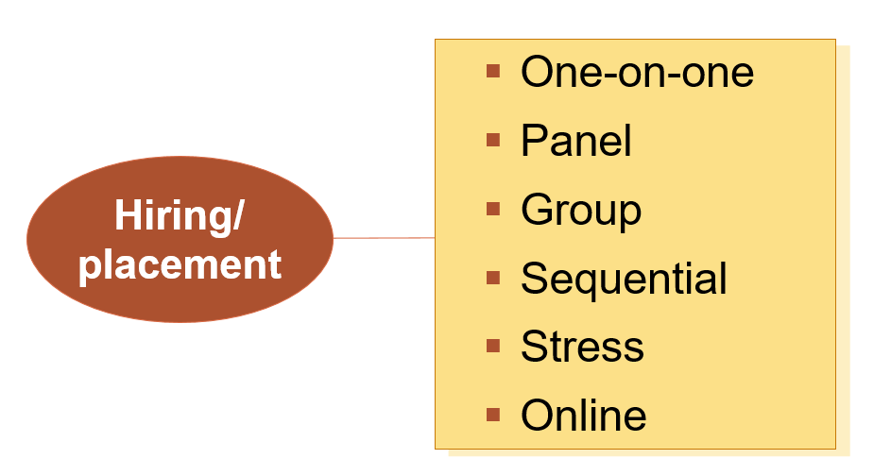

Slide 5
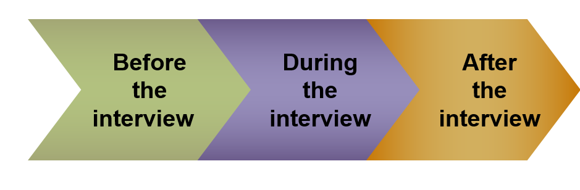
Interview Success

Slide 6
Professional Phone Techniques
Remember that anytime the phone rings, it could be a potential employer.
Alert those who may answer your phone; don’t let children answer.

Slide 7

An Impressive First Conversation
Keep the following near your phone:
Your résumé
List of positions for which you have applied
List of references
Calendar
Notepad and pen

Slide 8
Treat any call from an employer like an interview.
If caught off-guard, ask whether you can call back.
Be prepared for a screening interview.
Take good notes.
Get accurate directions.
Before you hang up, reconfirm date and time of interview.

Slide 9

Researching the Company
Never enter an interview cold!
Learn all you can about the target company.
Employers are impressed by candidates who have done their homework.

Slide 10
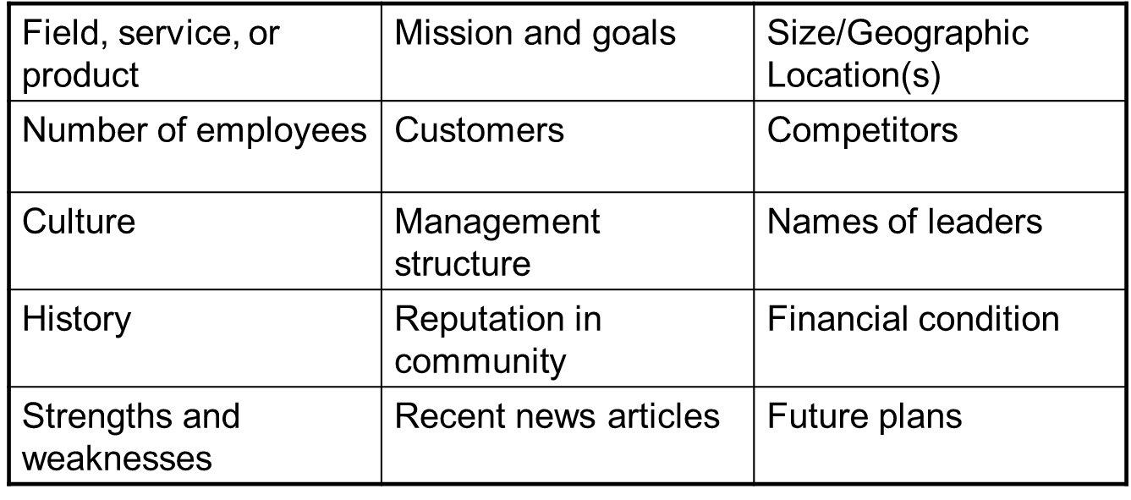
What should you look for?

Slide 11
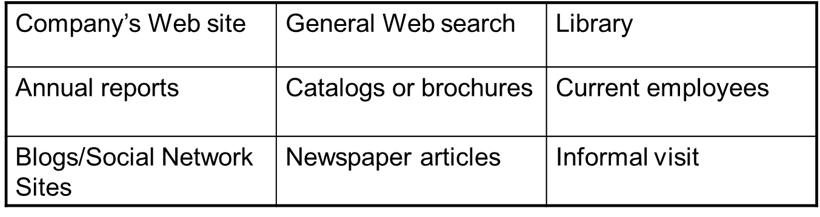
Where should you look?

Slide 12
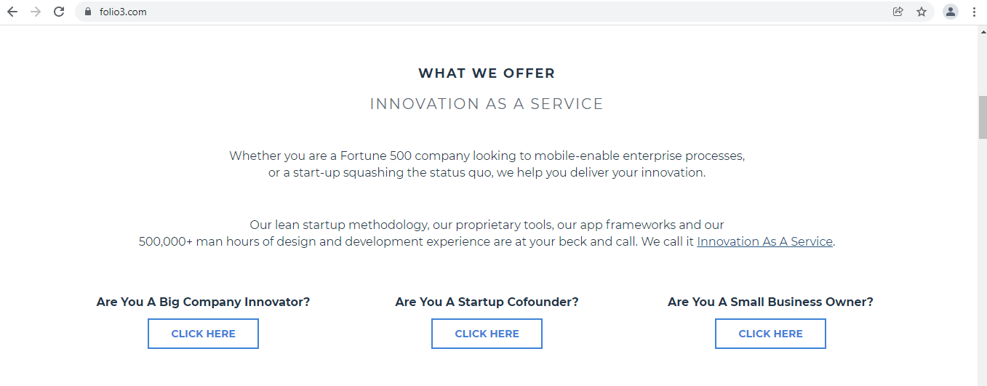

Slide 13
Prepare & Practice
How do your qualifications fit the job description?
Rehearse success stories.
Practice answers to typical interview questions.
Prepare to explain résumé problem areas.
Decide how to dress professionally.

Slide 14
How does your background relate to the position we have open?
A possible response:
As you know, I have just completed an intensive training program in _____________. In addition, I have over three years of part-time work experience in a variety of business settings. In one position I was selected to manage a small business in the absence of the owner. I developed responsibility and customer service skills in filling orders efficiently, resolving shipping problems, and monitoring key accounts. I also inventoried and organized products worth over $200,000. When the owner returned from a vacation to Florida, I was commended for increasing sales and was given a bonus in recognition of my efforts.
People relate to and remember stories. Try to shape your answers into memorable stories.

Slide 15
Traveling to Your Interview
Give yourself plenty of time to groom and dress.
Leave early enough so that you’ll arrive on time.
Don’t smoke or overdo the perfume or cologne.
If you are delayed, call immediately!

Slide 16
Arriving at Your Interview
Arrive on time or a little early.
When you enter, be courteous and congenial to everyone.
Greet the receptionist and wait for an invitation to sit.
Greet the interviewer confidently; don’t be afraid to initiate a handshake.

Slide 17
During the Interview
Control your body movements.
Exhibit good posture.
Practice appropriate eye contact.
Use gestures effectively.
Smile enough to convey a positive attitude.

Slide 18
Listen attentively.
Turn off your cell phone and other electronic devices—completely!
Sound enthusiastic and interested—but sincere.
Don’t chew gum.
Avoid empty words (um, uh, like, you know, basically).
Be confident

Slide 19
Answering Questions Effectively
Use the interviewer’s name occasionally. Pronounce it correctly!
Be sure you understand the question asked. If necessary, clarify vague questions, such as By ____ do you mean _____?
Aim your answers at key requirements for the job and at characteristics that interviewers seek: Expertise Communication skills Competence Enthusiasm for the job Initiative Decision-making skills Motivation Pleasing personality

Slide 20
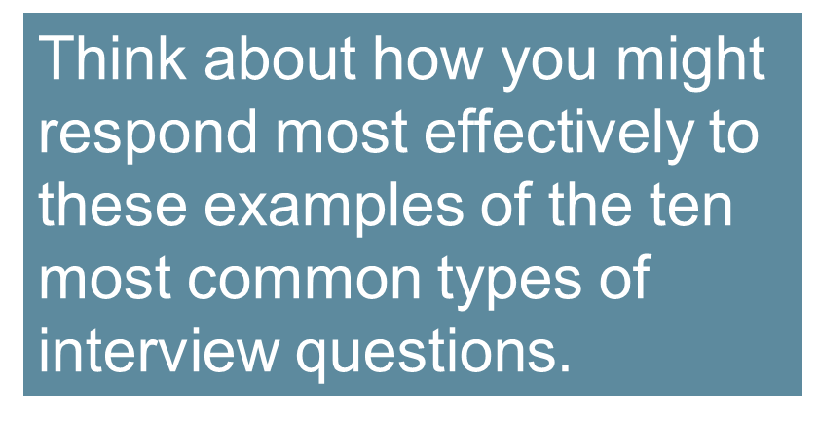
Kinds of Interview Questions

Slide 21
10 Most Important Questions
Get Used to/ Personal Questions:
Tell me about yourself.
What are your greatest strengths?
Determining Your Interest:
Why do you want to work for _______?
Why are you interested in this position?
Your Experience and Accomplishments:
Why should we hire you when we have applicants with more experience or better credentials?

Slide 22
10 Most Important Questions
The Future
Where do you expect to be five years from now?
What do you predict for the future of the ________ industry?
Challenging
What is your greatest weakness?
How would your former supervisor describe you as an employee?
Money
What are your salary expectations?
How much do you think you're worth?

Slide 23
10 Most Important Questions
Situational
If you were aware that a coworker was falsifying data, what would you do?
If you had to handle an irate customer, what would you do?
Behavioral (Use STAR technique)
Tell me about a time when you solved a difficult problem.
Describe a time when you worked successfully as part of a team.

Slide 24
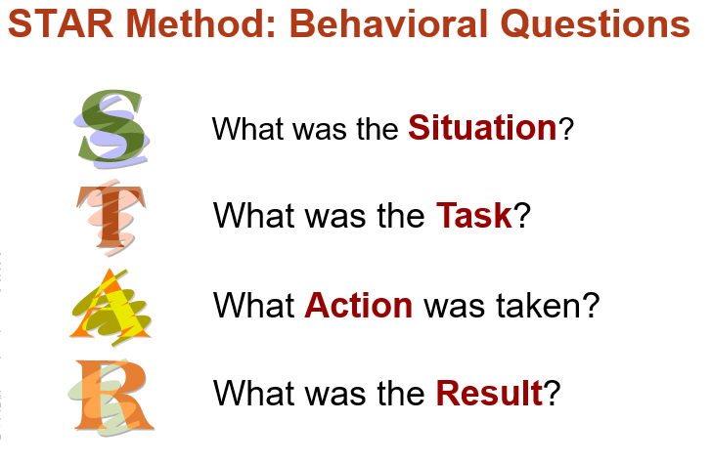
STAR Technique
Tell me about a time when you solved a difficult problem.
“When I was at Ace Products, we continually had a problem of excessive back orders. After analyzing the situation, I discovered that orders went through many unnecessary steps. I suggested that we eliminate much paperwork. As a result, we reduced back orders by 30 percent. Go on to emphasize what you learned and how you can apply that learning to this job. Practice your success stories in advance so that you will be ready”.

Slide 25
Illegal and Inappropriate
What is your marital status? Are you married? Do you live with anyone? Do you have a boyfriend (or girlfriend)?
Do you have any disabilities?
How old are you?
I notice you have an accent. Where are you from?
Have you ever been arrested?

Slide 26
Asking your own questions
Interviewee Questions
What will my duties be?
What is it like working here, in terms of the people, management practices, work loads, expected performance, and rewards?
What training programs does this organization offer?
Who would be my immediate supervisor?

Slide 27
Ending Positively
Wait for the interviewer to signal the end of the interview.
Summarize your strongest qualifications.
Demonstrate your interest in the position.
Don’t be afraid to say you want the job!
Find out what steps will follow.
Thank the interviewer.
Ask for a business card.
Shake hands confidently.
Thank the receptionist on the way out.

Slide 28
After the Interview
Write a thank-you letter to the interviewer: Remind the interviewer of your visit. Show that you really want the job. Prove that you are qualified for it.
Alert your references that they might be called.
If you don’t hear from the interviewer within the specified time, call or send and interview follow-up message.

Slide 29
After the Interview
Thank You Message
Dear Ms. Simmons:
Talking with you Thursday, May 27, about the graphic designer position was both informative and interesting.
Thanks for describing the position in such detail and for introducing me to Ms. Anderson, the senior designer. Her current project designing the annual report in four colors on a Macintosh sounds fascinating as well as quite challenging.

Slide 30
After the Interview
Now that I’ve learned in greater detail the specific tasks of your graphic designers, I’m more than ever convinced that my computer and creative skills can make a genuine contribution to your graphic productions. My training in Macintosh design and layout ensures that I could be immediately productive on your staff.
You will find me an enthusiastic and hard-working member of any team effort. As you requested, I’m enclosing additional samples of my work. I’m eager to join the graphics staff at your Santa Barbara headquarters, and I look forward to hearing from you soon.
Sincerely,

Slide 31
Interview Follow-Up Message
Dear Ms. Jamison:
I enjoyed my interview with you last Thursday for the receptionist position. You should know that I’m very interested in this opportunity with Coastal Enterprises.
Because you mentioned you might have an answer this week, I’m eager to know how your decision process is coming along. I look forward to hearing from you.
Sincerely,

Slide 32
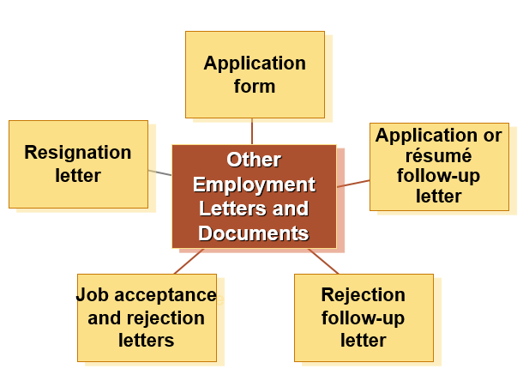

Slide 33

Interviews – The Dirty Dozen
According to recruiters, the following 12 things will hurt your chances during an interview:
Showing up late or too early
Treating the receptionist rudely
Having a poor handshake
Talking too much

Slide 34
Interviews – The Dirty Dozen
Dressing unprofessionally
Talking negatively about current or past employers/managers/jobs
Asking about benefits, vacation, or salary too soon
Not preparing for the interview

Slide 35
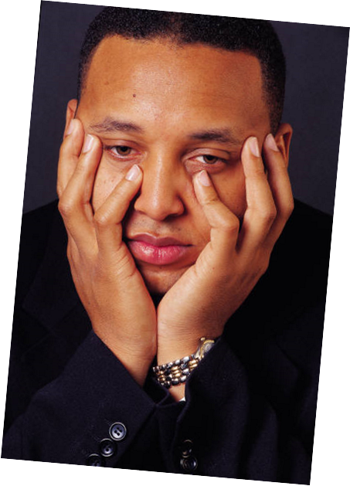
Interviews – The Dirty Dozen
Appearing bored or overly nervous
Not enough or too much eye contact
Failure to match communication styles
Acting desperate

Slide 36
Sample Video/Audio From British Council
https://learnenglish.britishcouncil.org/skills/listening/advanced-c1/a-job-interview
https://learnenglish.britishcouncil.org/skills/speaking/b2-upper-intermediate-an-interview

